Slide 1


The Sociology Pipeline for Today’s Graduate Students
Roberta Spalter-Roth, PhD
Director
Department of Research on the Discipline and Profession
American Sociological Association
Slide 1

Slide 2
Introduction
The purpose of this presentation is to provide you with information on career trajectories in sociology.
Includes jobs for masters’ degree recipients, the PhD job market, positions for post-docs, faculty salaries, non-academic jobs, mentoring for minority students, and career goals of women faculty.
The majority of this information comes from the American Sociological Association Research Department’s studies using surveys and unobtrusive data collection.
Today’s presentation comes from research briefs that can be found on the ASA web site: www.asanet.org/research/research.cfm.
Slide 2

Slide 3

Master’s Degree Recipients Careers
What Master’s Students Want
Note: Based on a regression model. Gray text indicates variables in the model that are not significant at the 0.05 level.
Source: American Sociological Association. What Can I Do with a Master's in Sociology, Wave III.
Slide 3

Slide 4
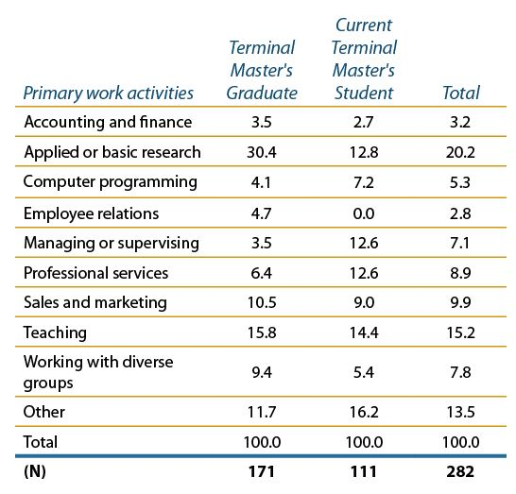
Master’s Degree Recipients Careers (continued)
Types of Job Activities Differ Between Terminal Master's Graduates and Current Students
(in percents).
Source: American Sociological Association. What Can I Do with a Master's in Sociology, Wave III.
Those who have obtained their degree in the previous year are significantly more likely than those still working on their degrees to do applied or basic research.
Slide 4

Slide 5
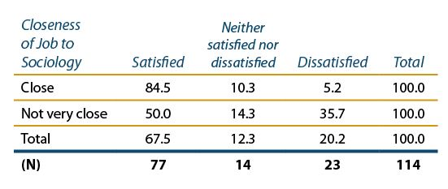
Master’s Degree Recipients Careers (continued)
Source: American Sociological Association. What Can I Do with a Master's in Sociology, Wave III.
Those who find jobs “close to sociology” are significantly more satisfied than those who do not.
Slide 5

Slide 6
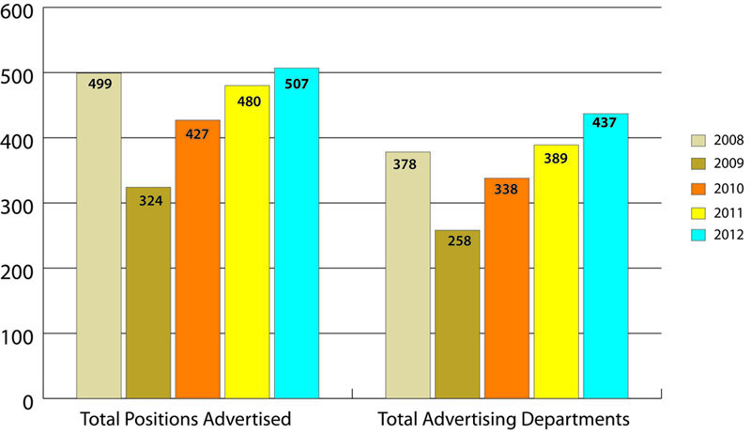
The PhD Job Market
Note: Excludes non-U.S. institutions.
Source: ASA Survey of Academic Employers, 2012-2013.
Number of advertised assistant and open/multiple rank positions has increased above 2008 pre-Great Recession period levels.
Slide 6

Slide 7
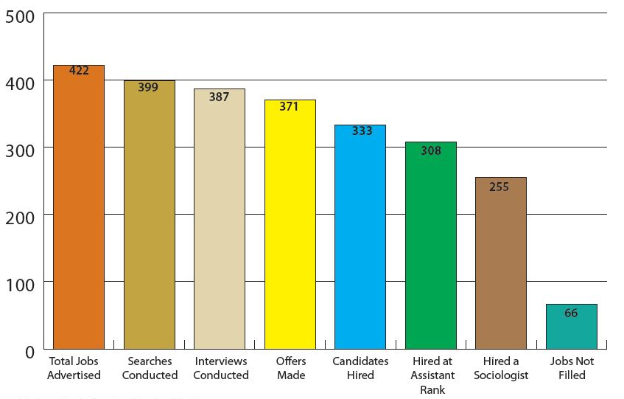
The PhD Job Market (continued)
Notes: Excludes foreign institutions.
Source: ASA Survey of Academic Employers, 2012-2013.
Each phase of the process results in an incremental decrease in filling the advertised positions; 84 percent success rate this year; 82 percent of those hired were sociologists.
Slide 7

Slide 8
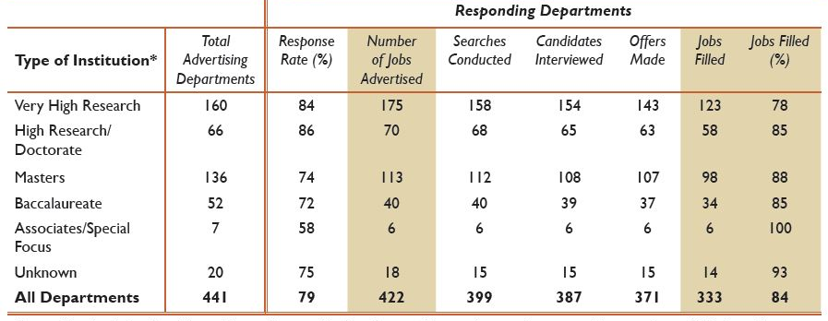
The PhD Job Market (continued)
Source: ASA Survey of Academic Employers, 2012-2013.
*Academic institution types are determined according to classification data provided by the Carnegie Foundation for the Advancement of Teaching; data available at http://classifications.carnegiefoundation.org/resources.
There is variation in the hiring process across types of institutions of higher education.
In 2012, Very High Research institutions advertised 41 percent of all assistant and open/multiple rank positions in the Job Bank.
However, those institutions filled a smaller percentage (78 percent) of positions than Research/Doctorate, Master’s Comprehensive, and Baccalaureate institutions (85 percent or higher for each).
Slide 8

Slide 9
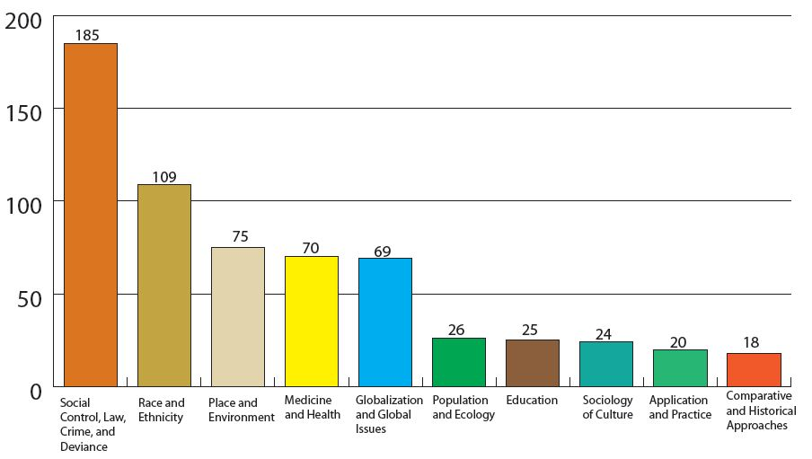
The PhD Job Market (continued)
Source: ASA Survey of Academic Employers, 2012-2013.
We identified up to three areas of academic specialization called for in each advertisement for assistant and open/multiple rank positions.
Social Control, Law, Crime, and Deviance remains number one, as in 2011.
Race and Ethnicity ranked second; in 2011 it ranked third.
Sociology of culture (the largest ASA section) is among the lowest.
Slide 9

Slide 10
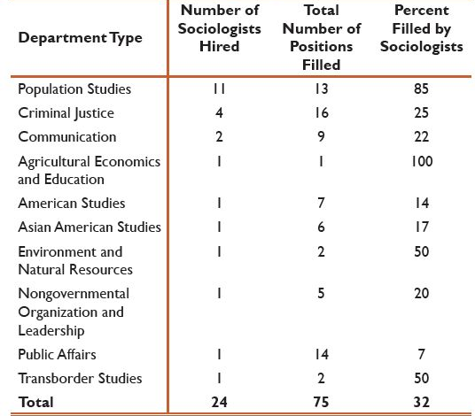
The PhD Job Market (continued)
Source: ASA Survey of Academic Employers, 2012-2013.
Note: For 76 responding departments, representing 112 positions (36 departments posted multiple positions). Of those 112 positions, 75 were filled, and of those 75, 24 (32%) were filled by sociologists.
24 non-sociology departments hired sociologists; in 2011, 34 such departments did so.
Largest number of sociologists was hired (85%) by population studies departments.
Criminal justice departments hired the second-largest number of sociologists, but those hires represented one-quarter of all positions filled by those departments.
Slide 10

Slide 11
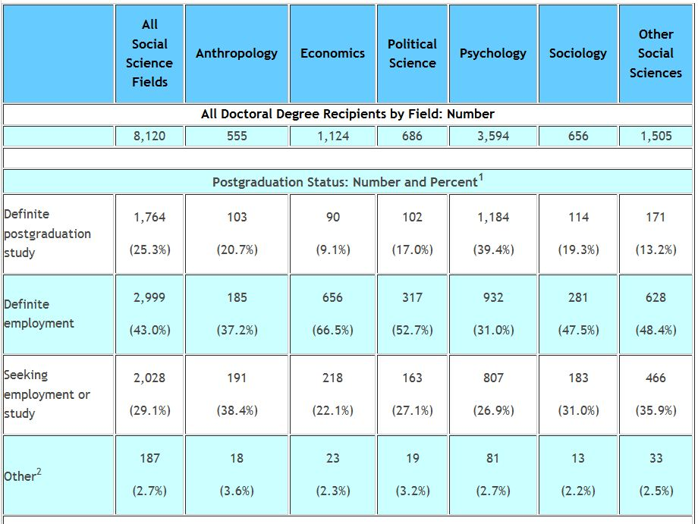
The PhD Job Market (continued)
Source: National Science Foundation/National Institutes of Health/USED/USDA/NEH/NASA, Survey of Earned Doctorates, 2011. Available at www.nsf.gov/statistics/sed/digest/2011.
Notes: ¹Only includes survey respondents who reported their postgraduation status; ²Includes respondents who indicated that they did not plan to work or study, respondents who indicated some other type of postgraduation plans, and respondents who indicated definite plans for other full-time degree program. X = suppressed to avoid disclosure of confidential information.
Sociologists are less likely to have definite employment plans post-graduation (61%) than economists or political scientists but more likely to have such plans than anthropologists or psychologists.
Slide 11

Slide 12
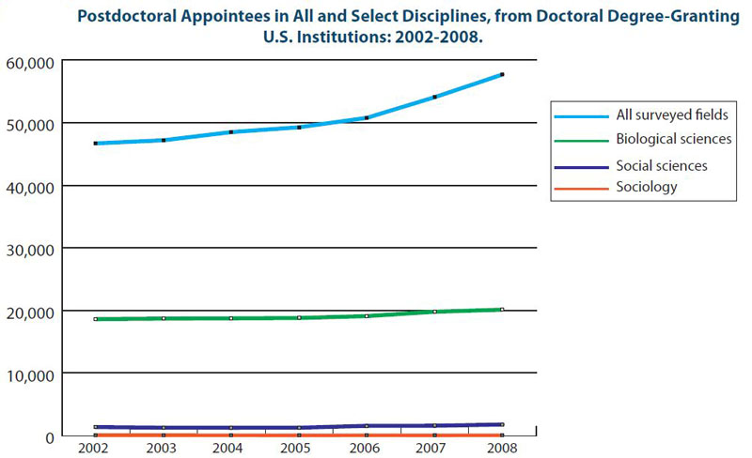
The PhD Job Market (continued)
Source: National Science Foundation. 2011. Graduate Students and Postdoctorates in Science and Engineering: Fall 2009, Table 69. Available at www.nsf.gov/statistics/nsf12300/content.cfm?pub_id=4118&id=2.
The postdoc has not as yet become a normative step in sociologists' career trajectories.
Slide 12

Slide 13
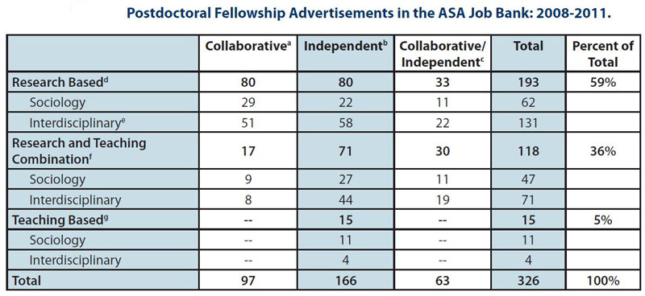
The PhD Job Market (continued)
Source: ASA Job Bank Database, 2011.
ªCollaborative: Research involves working with faculty and/or other students.
^{b}Independent: Recipients are expected to complete their own research projects.
^{c}Collaborative/Independent: Recipients are expected to collaborate with faculty and other students on research projects as well as complete their own research.
^{d}Research based: Recipients are required to complete their own research/dissertations and/or support faculty/others in carrying out research projects.
^{e}Interdisciplinary: The position requires one to participate in research/work that crosses disciplinary boundaries or makes use of multiple knowledge fields outside of sociology.
^{f}Research/Teaching: Recipients are required to complete research projects in addition to teaching at least one course per semester.
^{g}Teaching based: Recipients are expected to teach at least one course per semester with no research requirements.
The majority of postdoctoral positions are interdisciplinary, research-oriented, and are equally likely to require independent or collaborative research.
Slide 13

Slide 14
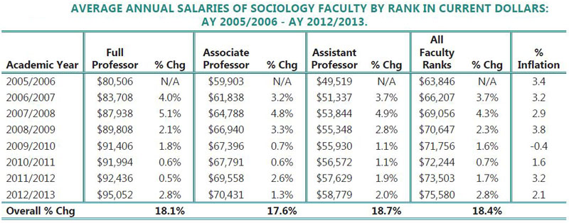
Faculty Salaries
Source: Adapted from College and University Professional Association for Human Resources. 2013. Faculty in Higher Education Salary Survey by Discipline, Rank and Tenure Status in Four-Year Colleges and Universities. Knoxville, TN: College and University Professional Association for Human Resources. www.cupahr.org/surveys/fhe4.aspx.
Between AY 2011/2012 and 2012/2013 faculty salaries increased in current dollars for all faculty ranks with the largest increases for assistant professors and full professors.
Slide 14

Slide 15
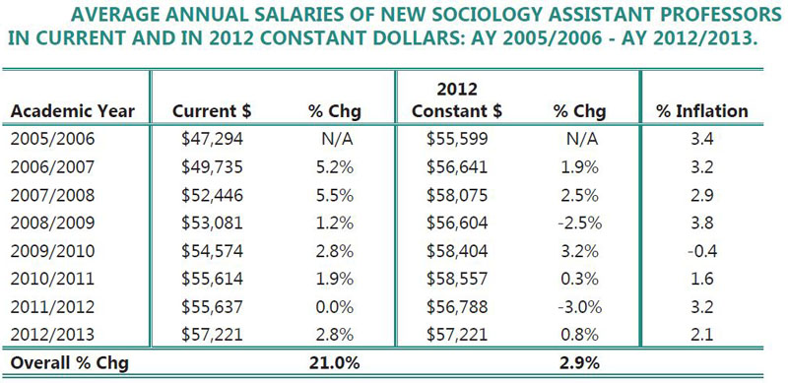
Faculty Salaries (continued)
Source: Adapted from College and University Professional Association for Human Resources. 2013. Faculty in Higher Education Salary Survey by Discipline, Rank and Tenure Status in Four-Year Colleges and Universities. Knoxville, TN: College and University Professional Association for Human Resources. www.cupahr.org/surveys/fhe4.aspx.
Between AY 2005/2006 and AY 2012/2013 the salaries of new assistant professors increased more than did all assistant professors (21% compared to 18.7%), but when examined in constant dollars the increase was only 2.9%.
Slide 15

Slide 16
Sociologists in Non-Academic Settings (Research and Applied)
*Sociology and Anthropology PhDs are combined in these years.
Source: National Science Foundation. Science Resources Statistics, Characteristics of Doctoral Scientists and Engineers in the United States (Arlington, VA: NSF, 1999 – 2006). www.nsf.gov/statistics/pubseri.cfm?seri_id=13#1993.
Unlike economists, sociologists are unlikely to work outside of the academy—Is this a reason that their salaries are substantially lower than economists?
Slide 16

Slide 17
Sociologists in Non-Academic Settings (continued)
*Source: American Sociological Association. Beyond the Ivory Tower: A Survey of Non-Academic PhDs in Sociology. (Washington, DC: ASA, 2006).
Health and education are the two top specialties of non-academics followed by statistics and demography (especially migration).
Slide 17

Slide 18
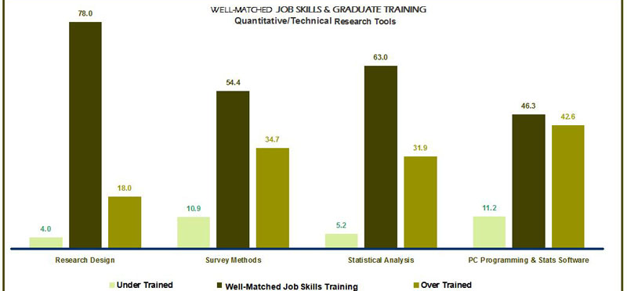
Sociologists in Non-Academic Settings (continued)
SKILLS MATCH BETWEEN GRADUATE TRAINING AND CURRENT JOB FOR SOCIOLOGISTS WORKING IN APPLIED RESEARCH SETTINGS (PERCENTAGE OF RESEARCHERS RESPONDING)
Notes: Under Trained: Important skills for current job but less than adequate training in graduate school.
Well-Matched Job Skills and Training: Important for current job and adequate training.
Over Trained: Less important skill for current job although adequate graduate training.
Source: American Sociological Association. Beyond the Ivory Tower: A Survey of Non-Academic PhDs in Sociology. (Washington, DC: ASA, 2006).
Sociologists employed beyond the ivory tower think that their training in research design, survey, and statistical tools are well-matched to their positions. They are less convinced that they have been trained to program and to use statistical software necessary for job performance, and do not think that they have been well-trained to write research proposals, do policy analysis, or program evaluation.
Slide 18

Slide 19
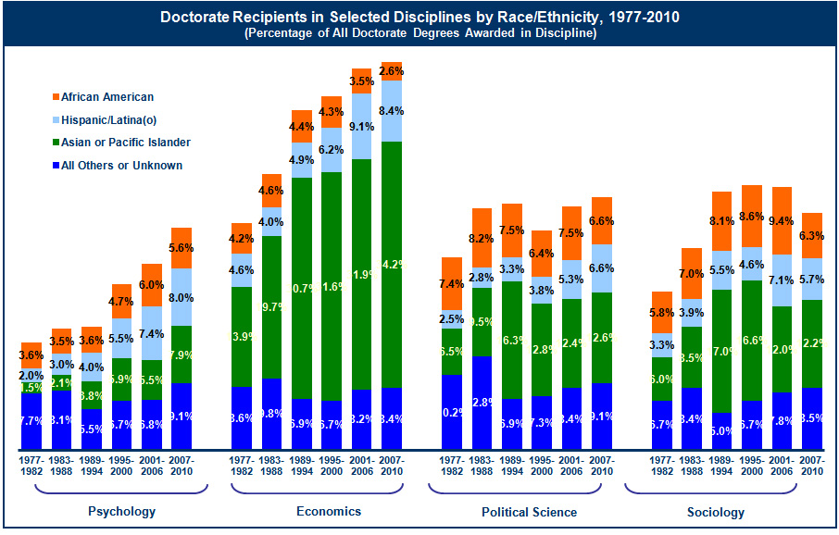
Minority PhDs in the Discipline
Source: National Science Foundation, Division of Science Resources Statistics. Survey of Earned Doctorates/Doctorate Records File. (Arlington, VA: NSF, 2011). http://caspar.nsf.gov.
The figure shows a gradual increase in minorities that earned doctorates in social science disciplines over the past two decades. In 2006, sociology had the highest percent of African-Americans earning doctorates, although not the highest number. As of 2006, economics had the highest percentage of Asian Americans earning doctorates in these disciplines, and the highest percentage of Hispanics (although the numbers are still extremely small). The year 2010, for the most part, continues these trends.
Slide 19

Slide 20
Minority PhDs in the Discipline (continued)
Information on the ASA Minority Fellowship Program
Pre-doctoral training program founded in 1974 at the behest of the then-Caucus of Black Sociologists (now the Association of Black Sociologists).
MFP was founded around the same period as similar training programs in psychology, nursing, and social work (funded by the National Institute of Mental Health).
The purpose of MFP was to address the severe underrepresentation of senior minority scholars as campuses became more diverse. This is still the major purpose.
Then and still today, MFP has been inclusive of all racial/ethnic minority groups in the discipline.
Slide 20

Slide 21
Minority PhDs in the Discipline (continued)
MFP Fellows and White Dissertation Advisors
Expected Probability of Academic Employment at a Research- Extensive University in 2010 for 1997-2009 Sociology PhD Graduates in Academic Positions by Group and Advisor
Having a white male advisor significantly benefits MFP participants in obtaining Research I faculty careers, although this type of relationship does not have significant effects on the other comparison groups.
Employment at a Research I university, in its turn, directly affects scholarly productivity, grant awards, and professional service for all groups.
Slide 21

Slide 22
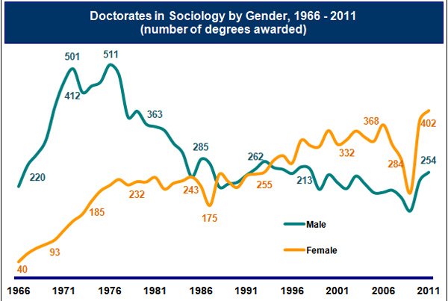
Women’s Career Goals in the Discipline
Source: U.S. Department of Education, National Center for Education Statistics (NCES), Integrated Post-secondary Education Data System (IPEDS) Completions, 1996-2010 (Washington, DC: NCES, 2011). https://webcaspar.nsf.gov.
The number of women receiving PhDs in sociology has grown steadily since 1966. In contrast, the number of degrees awarded to men has declined steadily after a growth spurt from the mid-1960s to the mid-1970s. This gap, however, narrows after 2007 when the number of PhD recipients declined overall, but has increased post-2007 as the number of new PhDs increased.
Slide 22

Slide 23
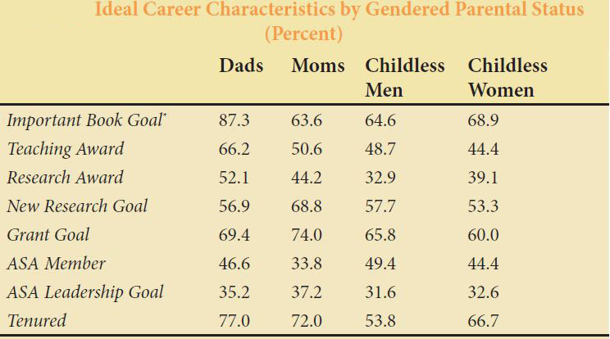
Women’s Career Goals in the Discipline (continued)
*Statistically significant at chi sq = .005.
Source: American Sociological Association. 2007. PhD+10: A Follow-up Survey on Career and Family Transitions In and Out of the Academic Sector. (Washington, DC: ASA).
Mothers are more likely than other groups to want to do new research and to get grants to do it. They are less likely to respond that they want to write an important book or win a research award than are fathers.
Slide 23

Slide 24
?
?
Questions or
Suggestions?
?
?
Slide 24

Slide 25

Thank you!
For further discussion or help, contact Roberta Spalter-Roth, PhD, at
202-383-9005 ext. 317 or by email at spalter-roth@asanet.org.
For free downloads of ASA Research Briefs, visit www.asanet.org/research/briefs_and_articles.cfm.
Slide 25

