Slide 1
Update on Common Core State Standards
August 22, 2012
Sandra Alberti, Ed.D.
Student Achievement Partners, Inc.

Slide 2
Agenda for the day
Background on the Common Core State Standards Initiative
English Language Arts and Literacy Standards
  Major Shifts
  Rationale
  Implications for teacher preparation
Mathematics Standards
  Major Shifts
  Rationale
  Implications for teacher preparation
Overview of Consortia Assessments and Other Implications

Slide 3
Rationale for the CCSS
Declining US competitiveness with other developed countries
High rates of college remediation
NAEP performance that is largely flat over the past 40 years in 8th grade
  Slight improvement at the 4th grade level
  Slight decline at the high school level

Slide 4
Principles of the CCSS
Fewer - Clearer - Higher
Aligned to requirements for college and career readiness
Based on evidence
Honest about time

Slide 5
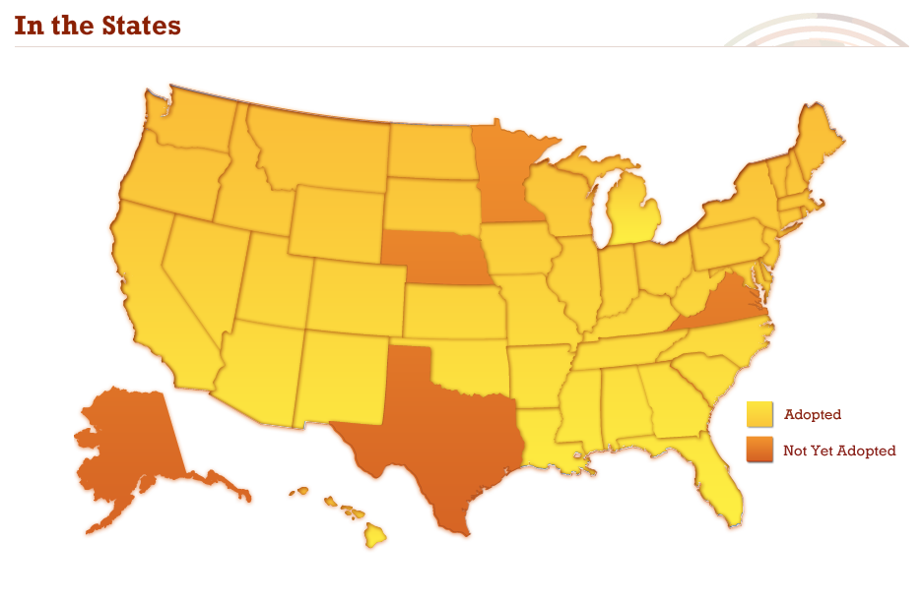
Where we are in CT and around the nation?

Slide 6
ELA/Literacy: 3 shifts
The What
Building knowledge through content-rich nonfiction

Slide 7
The Why: Shift One
Building knowledge through content-rich nonfiction
Much of our knowledge base comes from informational text
Informational text makes up vast majority of required reading in college/workplace (80%)
Informational text harder for students to comprehend than narrative text
Yet students are asked to read very little of it in elementary (7 - 15%) and middle school
CCSS moves percentages to
  50:50 at elementary level
  75:25 at secondary level (includes ELA, science, social studies)

Slide 8
ELA/Literacy: 3 shifts
The What
Building knowledge through content-rich nonfiction
Reading, writing, and speaking grounded in evidence from text, both literary and informational

Slide 9
The Why: Shift Two
Reading, writing & speaking grounded in evidence, both literary and informational
Most college and workplace writing is evidence-based and expository in nature (not narrative)
Ability to cite evidence differentiates student performance on NAEP
Standards in writing ask students to respond to evidence-based writing prompts (inform/argue)
Standards in speaking and listening require students to prepare for and refer to evidence on ideas under discussion
Standards in reading require students to respond to
text-dependent questions with evidence-based claims

Slide 10
ELA/Literacy: 3 shifts
The What
Building knowledge through content-rich nonfiction
Reading, writing, and speaking grounded in evidence from text, both literary and informational
Regular practice with complex text and its academic language

Slide 11
The Why: Shift Three
Regular Practice with Complex Text and its Academic Language
Gap between complexity of college and high school texts is huge
What students can read, in terms of complexity is greatest predictor of success in college (ACT study)
Too many students reading at too low a level
(<50% of graduates can read sufficiently complex texts)
Standards include a staircase of increasing text complexity from elementary through high school
Standards also focus on building vocabulary that is shared across many types of complex texts and many content areas

Slide 12
Mathematics: 3 shifts
The What
Focus: Focus strongly where the standards focus.

Slide 13
The Why: Shift One
Focus strongly where the Standards focus
Significantly narrow the scope of content and deepen how time and energy is spent in the math classroom
Focus deeply only on what is emphasized in the standards, so that students gain strong foundations

Slide 14
Traditional U.S. Approach
 | K 12
Number and Operations
Measurement and Geometry
Algebra and Functions
Statistics and Probability
Notes:
How U.S standards used to be arranged, giving equal importance to all four areas - like “shopping aisles.” Each grade goes up and down the aisles, tossing topics into the cart, losing focus. The CCSS domain structure communicates the changing emphases throughout the elementary years (e.g., Ratios and Proportional Relationships in grades 6 and 7).

Slide 15
Focusing attention within Number and Operations
 | Operations and Algebraic Thinking |  |  |  |  |  |  | Expressions and Equations |  |  |  | Algebra
 |  |  |  |  |  |  | → |  |  |  | →
 | Number and Operations—Base Ten |  |  |  |  |  | → | The Number System
 |  |  |  |  |  |  |  |  |  |  | →
 |  |  |  | Number and Operations—Fractions |  |  | →
 | K | 1 | 2 | 3 | 4 | 5 |  | 6 | 7 | 8 |  | High School

Slide 16
Mathematics: 3 shifts
The What
Focus: Focus strongly where the standards focus.
Coherence: Think across grades, and link to major topics

Slide 17
The Why: Shift Two
Coherence Think across grades, and link to major topics within grades
Carefully connect the learning within and across grades so that students can build new understanding onto foundations built in previous years.
Begin to count on solid conceptual understanding of core content and build on it. Each standard is not a new event, but an extension of previous learning.

Slide 18
Coherence: Think across grades
Fraction example:
“The coherence and sequential nature of mathematics dictate the foundational skills that are necessary for the learning of algebra. The most important foundational skill not presently developed appears to be proficiency with fractions (including decimals, percents, and negative fractions). The teaching of fractions must be acknowledged as critically important and improved before an increase in student achievement in algebra can be expected.”
Final Report of the National Mathematics Advisory Panel (2008, p. 18)
Notes:
Carefully laid progressions of conceptual development, not just moving topics earlier in the grade sequence.

Slide 19
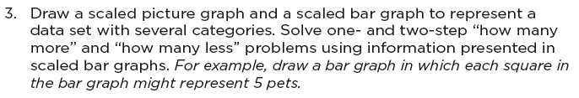
Coherence: Link to major topics within grades
Example: data representation
Standard 3.MD.3
Notes:
Instead of bar charts being “yet another thing to cover,” detracting from focus, the standard is telling you how to “aim” bar charts back around to the major work of the grade.

Slide 20
Coherence: Link to major topics within grades
Example: Geometric measurement
3.MD, third cluster
Notes:
Another example: Area is not just another topic to cover in Grade 3. It is explicitly linked to multiplication and division in the standards.

Slide 21
Mathematics: 3 shifts
The What
Focus: Focus strongly where the standards focus.
Coherence: Think across grades, and link to major topics
Rigor: In major topics, pursue conceptual understanding, procedural skill and fluency, and application

Slide 22
The Why: Shift Three
Rigor In major topics, pursue conceptual understanding, procedural skill and fluency, and application
The CCSSM require a balance of:
  Solid conceptual understanding
  Procedural skill and fluency
  Application of skills in problem solving situations
This requires equal intensity in time, activities, and resources in pursuit of all three
Notes:
This shift is about the depth of what is expected in the standards, and also about what one should expect to see happening in the classroom, in curricular materials, and so on.

Slide 23
Priorities in Mathematics
Grade | Priorities in Support of Rich Instruction and Expectations of Fluency and Conceptual Understanding
K–2 | Addition and subtraction, measurement using whole number quantities
3–5 | Multiplication and division of whole numbers and fractions
6 | Ratios and proportional reasoning; early expressions and equations
7 | Ratios and proportional reasoning; arithmetic of rational numbers
8 | Linear algebra

Slide 24
Required Fluencies in K-6
Grade | Standard | Required Fluency
K | K.OA.5 | Add/subtract within 5
1 | 1.OA.6 | Add/subtract within 10
2 | 2.OA.2 2.NBT.5 | Add/subtract within 20 (know single-digit sums from memory) Add/subtract within 100
3 | 3.OA.7 3.NBT.2 | Multiply/divide within 100 (know single-digit products from memory) Add/subtract within 1000
4 | 4.NBT.4 | Add/subtract within 1,000,000
5 | 5.NBT.5 | Multi-digit multiplication
6 | 6.NS.2,3 | Multi-digit division Multi-digit decimal operations
Notes:
Fluent in the particular Standards cited here means “fast and accurate.” It might also help to think of fluency as meaning the same thing as when we say that somebody is fluent in a foreign language: when you’re fluent, you flow. Fluent isn’t halting, stumbling, or reversing oneself.
The word fluency was used judiciously in the Standards to mark the endpoints of progressions of learning that begin with solid underpinnings and then pass upward through stages of growing maturity.
Some of these fluency expectations are meant to be mental and others with pencil and paper. But for each of them, there should be no hesitation in getting the answer with accuracy.

Slide 25
Mathematical Practices
Make sense of problems and persevere in solving them.
Reason abstractly and quantitatively.
Construct viable arguments and critique the reasoning of others.
Model with mathematics.
Use appropriate tools strategically.
Attend to precision.
Look for and make use of structure.
Look for and express regularity in repeated reasoning.
Don’t Bureaucratize

Slide 26
General Notes about Implementation
The CCSS uses an eraser and pen and provides time and space to focus on doing fewer things better
Implementation of the CCSS must be integrated into other efforts of educational improvement, not one more thing
Commit to a small number of metrics that address
  Teacher Practice and Knowledge
  Instructional Materials and Resources
  Student Work

Slide 27
Resources
www.achievethecore.org
www.pta.org/4446.htm
http://www.cgcs.org/domain/36
http://parcconline.org/parcc-content-frameworks
www.Illustrativemathematics.org

Slide 28
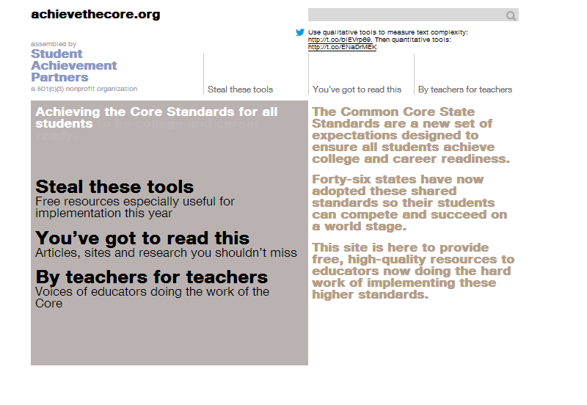
Achievethecore.org
Twitter handle: @achievethecore

Slide 29
PARCC’s Fundamental Advance
PARCC is designed to reward quality instruction aligned to the Standards, so the assessment is worthy of preparation rather than a distraction from good work.

Slide 30
PARCC’s Core Commitments to Mathematics Assessment Quality
Focus: PARCC assessments will focus strongly on where the Standards focus. Students will have more time to master concepts at a deeper level.
Problems worth doing: Multi-step problems, conceptual questions, applications, and substantial procedures will be common, as in an excellent classroom.
Better Standards Demand Better Questions: Instead of reusing existing items, PARCC will develop custom items to the Standards.
Fidelity to the Standards (now in Teacher’s hands): PARCC evidences are rooted in the language of the Standards so that expectations remain the same in both instructional and assessment settings.

Slide 31
PARCC’s Core Commitments to ELA/Literacy Assessment Quality
Texts Worth Reading: The assessments will use authentic texts worthy of study instead of artificially produced or commissioned passages.
Questions Worth Answering: Sequences of questions that draw students into deeper encounters with texts will be the norm (as in an excellent classroom), rather than sets of random questions of varying quality.
Better Standards Demand Better Questions: Instead of reusing existing items, PARCC will develop custom items to the Standards.
Fidelity to the Standards (now in Teachers’ hands): PARCC evidences are rooted in the language of the Standards so that expectations remain the same in both instructional and assessment settings.

Slide 32
Other areas of impact
Measures of Teacher Effectiveness
Procurement policies
  Publishers’ Criteria for ELA/Literacy
  Publishers’ Criteria for Mathematics

