Slide 1
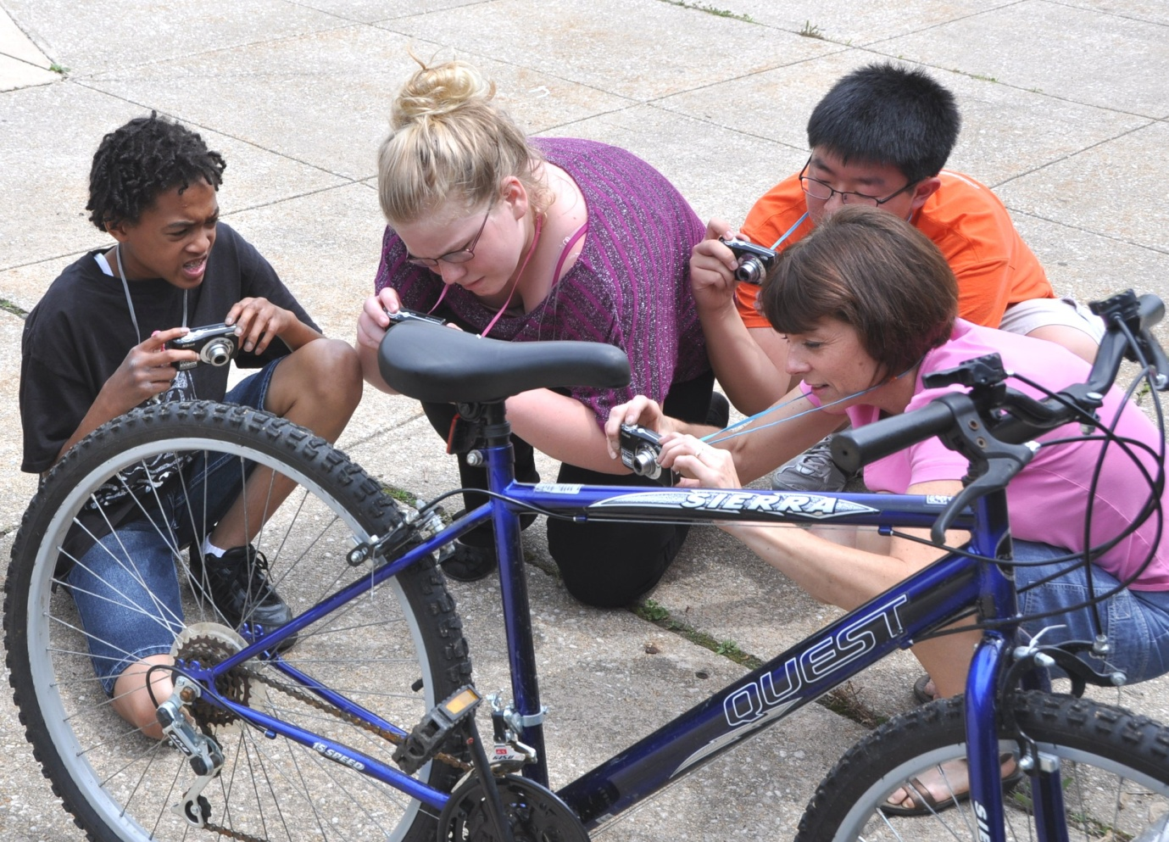
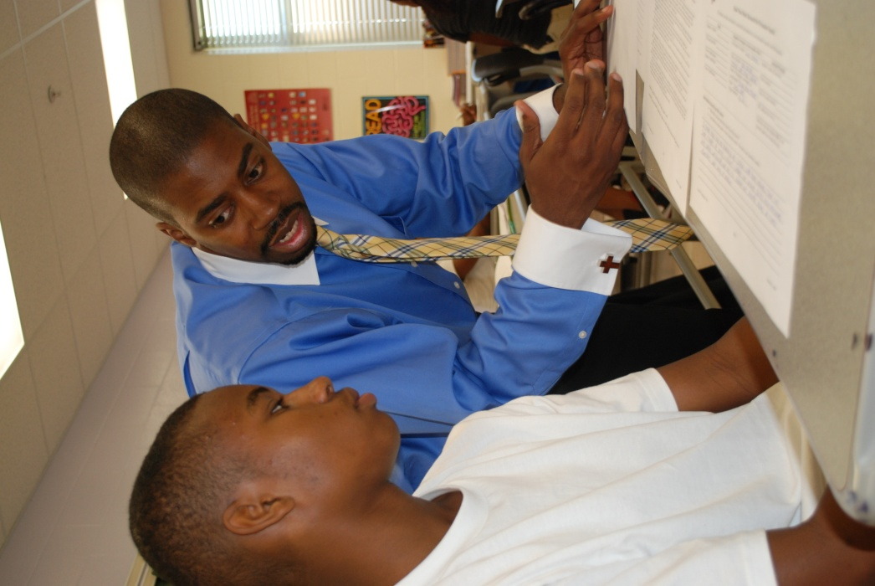

DEVELOPING GREAT TEACHERS
Presentation to Towson University College of Education Faculty
August 22, 2012
S. Dallas Dance, Ph.D.,
Superintendent

Slide 2

WE DO SO MANY
THINGS WELL.
4th highest graduation rate in the nation
> 50% of high schools among the best in the nation
13 National and 16 Maryland Blue Ribbon Schools
Multiple excellence awards for:
Title I Physical education
Magnet programs Budget and facilities management
Arts education Music education…

Slide 3


Baltimore County Public Schools
And
Towson University
WE DO SO MANY THINGS
TOGETHER.
Cohorts
47 professional development school partnerships
6 Baltimore County public schools are supported
Teacher educators in residence
Baltimore County Public Schools
And
Towson University

Slide 4
DEVELOPING GREAT TEACHERS

Slide 5
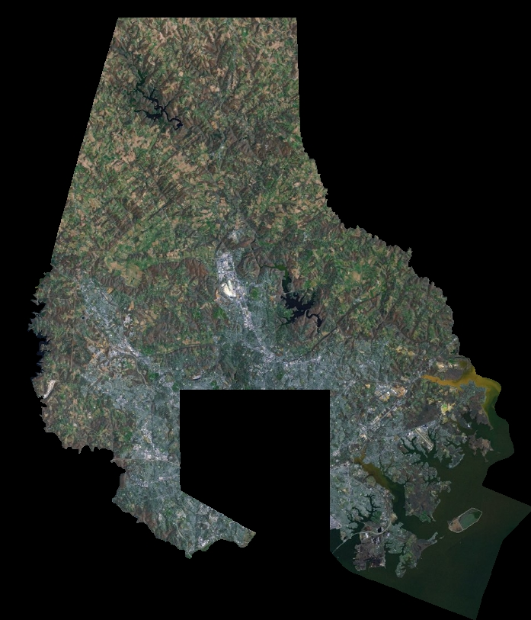
HIGH-PERFORMING
SCHOOLS IN
EVERY
COMMUNITY

Slide 6

ALL
MEANS ALL
“Brainpower does not discriminate by gender or race or faith or background. Everybody has got the capacity to create and improve our lives in so many ways.”
President Barack Obama

Slide 7

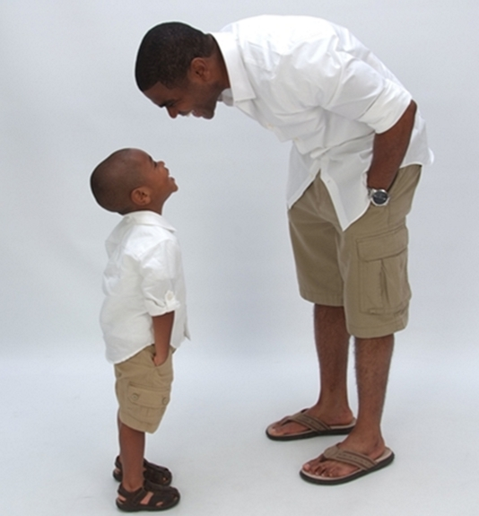
OUR OWN
CHILDREN
I want for every child
what I want for my own son.

Slide 8
DEVELOPING GREAT TEACHERS

Slide 9
2011 SAT MEAN SCORES

Slide 10
4-YEAR ADJUSTED COHORT
GRADUATION RATE FOR 2011

Slide 11
2011 END OF GRADE 10 HSA STATUS
(% PASSING)

Slide 12
2012 MSA READING AND MATH
PERFORMANCE, GRADES 3-8
(% PROFICIENT AND ADVANCED)
Reading
Math

Slide 13
2012 MSA READING PERFORMANCE
MIDDLE (% PROFICIENT AND ADVANCED)

Slide 14
2012 MSA MATH PERFORMANCE
MIDDLE (% PROFICIENT AND ADVANCED)

Slide 15
4 -YEAR ADJUSTED COHORT
GRADUATION RATE
BY SERVICE GROUP

Slide 16
MAIN FOCUS AREAS
Middle School Achievement
Special Education

Slide 17
ASSOCIATION FOR
MIDDLE LEVEL EDUCATION
Knowledge of young adolescents and their developmental characteristics
Knowledge of the philosophy, organization, and curriculum
Knowledge of developmentally and culturally responsive practices
Appropriate field experience
Collaborative knowledge and experience
Preparation in the knowledge base of two or more subject matter fields

Slide 18
MAIN FOCUS AREAS
Middle School Achievement
Special Education

Slide 19
DIFFERENTIATED-TIERED SUPPORT MODEL
More central staff-directed
Less self-directed
Tier
III
Tier
III
Tier II
More self-directed
Less central staff-directed
Tier I

Slide 20

FOUR CRITICAL GOALS
1
2
3
4
Blueprint 2.0
High-quality curriculum
Professional development
Timely,
transparent,
and clear communications

Slide 21
NEW TEACHERS
NEED TO BE ADEPT IN
Boosting the depth of curriculum content
Being collaborative – both with colleagues and students
Integrating innovative teaching strategies
Using data to inform instructional decisions

Slide 22
DEVELOPING GREAT TEACHERS

Slide 23
THIS NATION’S STUDENTS SAY
THAT SCHOOL IS TOO EASY.
37% of Grade 4 students said math was too easy.
57% of Grade 8 students said history was too easy.
39% of seniors said they were rarely required to write about in-class readings.

Slide 24
DEVELOPING GREAT TEACHERS

Slide 25
NEW TEACHERS
NEED TO BE ADEPT IN
Boosting the depth of curriculum content
Being collaborative – both with colleagues and students
Integrating innovative teaching strategies
Using data to inform instructional decisions

Slide 26
DEVELOPING GREAT TEACHERS

