Slide 1
Towson University
Teacher Preparation Faculty
Overview of the Maryland Teacher and Principal Evaluation Models
Dave Volrath
Teacher and Principal Evaluation Lead
Maryland State Department of Education
April 22, 2013

Slide 2

2010 Education Reform Act
Probationary period extended to three years for tenure with tenure transportable
Performance evaluations to include observations, clear standards, rigor, evidence of observed instruction
Model Performance evaluation criteria mutually agreed on by the LEA and the exclusive employee representative
Data on Student Growth as a significant component of the evaluation and as one of the multiple measures
Student growth as progress assessed from a clearly articulated baseline to one or more points in time
Student growth as progress assessed by multiple measures and not based solely on an existing or newly created single exam or assessment
Existing or newly created assessments may be used as one of the multiple measures
No single criteria shall account for more than 35% of the total performance criteria
All LEAs
ESEA Flexibility Waiver
All LEAs
Principle 3 Requires 20% MSA (for attributable) elementary and middle school teacher and principal evaluation
Principle 3 Requires each high school teacher (in tested areas) and principal to include one Student Learning Objective with a data point on student performance on Statewide high school assessments in the evaluation
Principle 3 Requires Ratings of Highly Effective, Effective , and Ineffective in SY 2013-2014.
Race To The Top Participants
22 LEAs
Annual evaluation of tenured and effective or highly effective teachers on a three year evaluation cycle
Annual evaluation of principals and non-tenured or ineffective teachers on yearly cycle
Approved evaluation model of local or state design
Agreement on model by LEA and the exclusive employee representative
Default to the state model if the local model is not approved or not agreed upon by the exclusive employee representative
Professional Practice value of 50%
Student Growth value of 50%
Rating of teachers and principals according to Highly Effective, Effective, or Ineffective
Appeal process provided
Results reported
Educator Effectiveness and Teacher/Principal Evaluation
Other
Items
Attribution: Associating students enrolled on 9/30, still enrolled on the day of testing, and present 80% of the instructional days to the teacher of record
Teacher of Record: The teacher(s) most directly responsible for the delivery of the instruction to the student
Evaluation Cycle: Tenured and Effective or Highly Effective Educators = Student Growth annually and Professional Practice every three years
Untenured and Ineffective Educators = Student Growth annually and Professional Practice annually
Professional Practice Teacher: Four Domains; Planning & Preparation, Instruction, Classroom Environment, Professional Responsibilities
Professional Practice Principals: Eight Maryland Instructional Leadership Framework Domains, and Four ISLLC Domains
School Progress Index: Annual whole-school accountability measure of school performance than can be used in teacher and principal evaluation
Student Learning Objectives: Measures of student growth associated with cohorts of students and generated by teacher and principal interests
Teacher & Principal Ratings: Determinations of Highly Effective, Effective, or Ineffective as required in COMAR 13A.07.09
3/15/13

Slide 3
2010 Education Reform Act
All LEAs
Probationary period extended to three years for tenure with tenure transportable
Performance evaluations to include observations, clear standards, rigor, evidence of observed instruction
Model Performance evaluation criteria mutually agreed on by the LEA and the exclusive employee representative
Data on Student Growth as a significant component of the evaluation and as one of the multiple measures
Student growth as progress assessed from a clearly articulated baseline to one or more points in time
Student growth as progress assessed by multiple measures and not based solely on an existing or newly created single exam or assessment
Existing or newly created assessments may be used as one of the multiple measures
No single criteria shall account for more than 35% of the total performance criteria

Slide 4
ESEA Flexibility Waiver
All LEAs
Principle 3 Requires 20% MSA (for attributable) elementary and middle school teacher and principal evaluation
Principle 3 Requires each high school teacher (in tested areas) and principal to include one Student Learning Objective with a data point on student performance on Statewide high school assessments in the evaluation
Principle 3 Requires Ratings of Highly Effective, Effective , and Ineffective in SY 2013-2014.

Slide 5
Race To The Top Participants
22 LEAs
Annual evaluation of tenured and effective or highly effective teachers on a three year evaluation cycle
Annual evaluation of principals and non-tenured or ineffective teachers on yearly cycle
Approved evaluation model of local or state design
Agreement on model by LEA and the exclusive employee representative
Default to the state model if the local model is not approved or not agreed upon by the exclusive employee representative
Professional Practice value of 50%
Student Growth value of 50%
Rating of teachers and principals according to Highly Effective, Effective, or Ineffective
Appeal process provided
Results reported

Slide 6
Other
Items
Attribution: Associating students enrolled on 9/30, still enrolled on the day of testing,
and present 80% of the instructional days to the teacher of record
Teacher of Record: The teacher(s) most directly responsible for the delivery of the
instruction to the student
Evaluation Cycle:
  Tenured and Effective or Highly Effective Educators = Student Growth annually and
  Professional Practice every three years
  Untenured and Ineffective Educators = Student Growth annually and Professional
  Practice annually
Professional Practice Teacher: Four Domains; Planning & Preparation, Instruction,
Classroom Environment, Professional Responsibilities
Professional Practice Principals: Eight Maryland Instructional Leadership Framework
Domains, and Four ISLLC Domains
School Progress Index: Annual whole-school accountability measure of school
performance than can be used in teacher and principal evaluation
Student Learning Objectives: Measures of student growth associated with cohorts of
students and generated by teacher and principal interests
Teacher & Principal Ratings: Determinations of Highly Effective, Effective, or Ineffective as
required in COMAR 13A.07.09

Slide 7

State Teacher Evaluation Model
Professional Practice
Student Growth
50 % Qualitative Measures
4 Domains Each 12.5%
50% Quantitative Measures
As defined below
Planning and
Preparation
12.5 %
Instruction
12.5 %
Classroom Environment
12.5 %
Professional
Responsibilities
12.5 %
Elementary/Middle School Teacher
Two Content Areas
10% - Reading MSA (Class)
and
10% - Math MSA (Class)
and
10% - School Performance
Index
and
20% - Student Learning
Objectives
Elementary/Middle School Teacher
One Content Area
English/Language Arts Teachers:
20% - Reading MSA (Class)
and
10% - School Performance Index
and
20% - Student Learning Objectives
Mathematics Teachers:
20% - Math MSA (Class)
and
10% - School Performance Index
and
20% - Student Learning Objectives
Elementary/Middle School Teacher
Non-Tested Subject
15% - School Performance
Index
and
35% - Student Learning
Objectives
High School
Teacher
15% - School Performance
Index
and
35% - Student Learning
Objectives
or
or
or
9/27/12

Slide 8
State Principal Evaluation Model
Professional Practice
Student Growth
50% Qualitative Measures
12 Domains Each 2-10%
50% Quantitative Measures
As defined below
Maryland Instructional Leadership Framework (8)
School Vision
School Culture
Curriculum, Instruction, and Assessment
Observation/Evaluation of Teachers
Integration of Appropriate Assessments
Use of Technology and Data
Professional Development
Stakeholder Engagement
Interstate School Leaders and Licensure Consortium (4)
School Operations and Budget
Effective Communication
Influencing the School Community
Integrity, Fairness, and Ethics
Elementary/Middle School Principals
10% - Reading MSA (School)
and
10% - Math MSA (School)
and
10% - School Performance Index
and
20% - Student Learning Objectives
High School
Principals
15% - School Performance Index
and
35% - Student Learning Objectives
Other Principals (e.g., Special Center, PreK-2)
15% - School Performance Index
and
35% - Student Learning Objectives
or
or
9/27/12

Slide 9
# Revised 9/17/2012: Submitted to USDE for Approval
Maryland School #Progress Index
Grades PreK-8
Grades 9-12
Meeting Performance Targets
(AMO)
Meeting Performance Targets
(AMO)
Achievement*
30%
Achievement*
40%
33.3%- Mathematics Proficiency (MSA)
33.3%- Reading Proficiency (MSA)
33.3%- Science Proficiency (MSA)
33.3%- Mathematics Proficiency (Algebra/
Data Analysis HSA)
33.3%- English Proficiency (English HSA)
33.3%- Science Proficiency (Biology HSA)
Gap*
40%
Gap*
40%
Gap between lowest subgroup and highest subgroup within a school:
Gap between lowest subgroup and highest subgroup within a school:
  33.3%- Mathematics Proficiency (MSA)
  33.3%- Reading Proficiency (MSA)
  33.3%- Science Proficiency (MSA)
  20%- Mathematics Proficiency (Algebra/
  Data Analysis HSA)
  20%- English Proficiency (English HSA)
  20%- Science Proficiency (Biology HSA)
  20%- Cohort Graduation Rate
  20%- Cohort Dropout Rate
Growth*
30%
#College-and Career-Readiness*
20%
Percent of students making one year’s growth:
60%- Cohort Graduation rate
40%- College and Career Preparation (CCP)
  Advanced Placement
  Career and Technology Education (CTE) Concentrators
  College Enrollment
50%- Mathematics Proficiency (MSA)
50%- Reading Proficiency (MSA)
*ALT-MSA is included in the index component

Slide 10
Local Teacher Evaluation Models
Professional Practice
Student Growth
50 % Qualitative Measures
Domain percentages proposed by LEA and approved by MSDE
50 % Quantitative Measures
As defined below
Planning and
Preparation
Instruction
Classroom Environment
Professional
Responsibilities
Additional Domains Based on Local Priorities
Elementary/Middle School Teacher
Two Content Areas
10 % - Reading MSA (Class)
and
10 % - Math MSA (Class)
and
30% - LEA proposed objective measures of student growth and learning linked to state and/or local goals and approved by MSDE
Elementary/Middle School Teacher
One Content Area
English/Language Arts Teachers:
20% - Reading MSA (Class)
and
30% - LEA proposed objective measures of student growth and learning linked to state and/or local goals and approved by MSDE
Mathematics Teachers:
20% - Math MSA (Class)
and
30% - LEA proposed objective measures of student growth and learning linked to state and/or local goals and approved by MSDE
Elementary/Middle School Teacher
Non-Tested Subject
LEA proposed objective measures of student growth and learning linked to state and/or local goals and approved by MSDE; no single measure to exceed 35%
High School
Teacher
LEA proposed objective measures of student growth and learning linked to state and/or local goals and approved by MSDE; no single measure to exceed 35%
or
or
or
9/27/12

Slide 11
Local Principal Evaluation Models
Professional Practice
Student Growth
50 % Qualitative Measures
Domain percentages proposed by LEA and approved by MSDE
50 % Quantitative Measures
As defined below
Maryland Instructional Leadership Framework (8)
School Vision
School Culture
Curriculum, Instruction, and Assessment
Observation/Evaluation of Teachers
Integration of Appropriate Assessments
Use of Technology and Data
Professional Development
Stakeholder Engagement
Additional Domains Based on Local Priorities
Elementary/Middle School Principals
10 % - Reading MSA (School)
and
10 % - Math MSA (School)
and
30% - LEA proposed objective measures of student growth and learning linked to state and/or local goals and approved by MSDE
High School
Principals
LEA proposed objective measures of student growth and learning linked to state and/or local goals and approved by MSDE; no single measure to exceed 35%
Other Principals (e.g., Special Center, PreK-2)
LEA proposed objective measures of student growth and learning linked to state and/or local goals and approved by MSDE; no single measure to exceed 35%
or
or
9/27/12

Slide 12
Teacher
Evaluation
___________
Professional Practice | 50%
Classroom Environment
Instruction
Planning & Preparation
Student Learning Objectives | 30%
MSA/PARCC | 20%
Teacher Controlled
Elements
State Test Measures
Tested Area Teacher Example

Slide 13
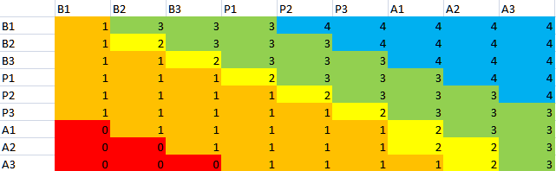
Maryland Tiered Achievement Index:
Field Test Version

Slide 14
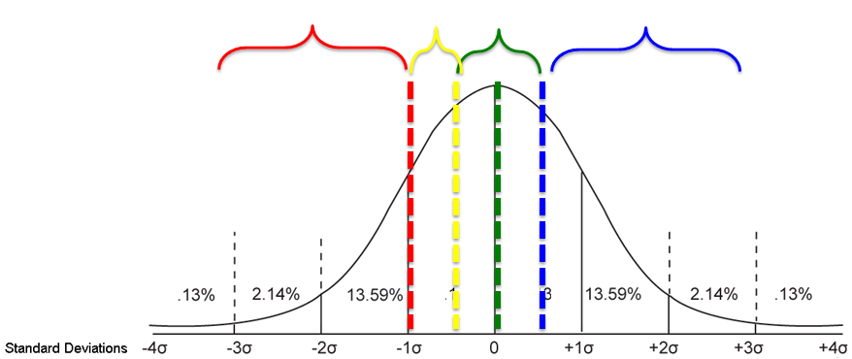
A CCPS approach to using the Standard Deviation to interpret performance
Performance spanning the grade mean by one standard deviation is considered expected and acceptable (green bracket).
Growth more than .5 STD above mean is beyond expected and commendable (blue bracket).
Performance .5 STD below the central range is concerning (yellow bracket); performance a full STD below mean is a significant loss and unacceptable (red bracket).
Slide borrowed from CCPS presentation, March 11, 2013

Slide 15
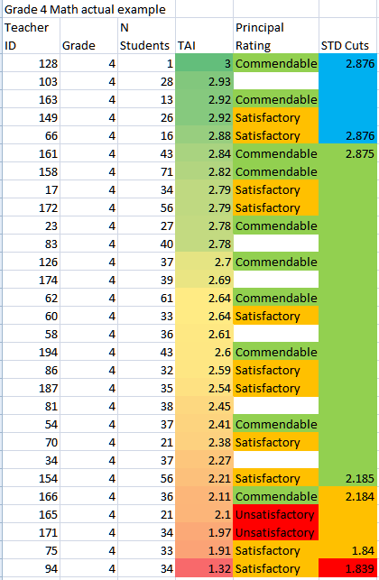
A real example

Slide 16
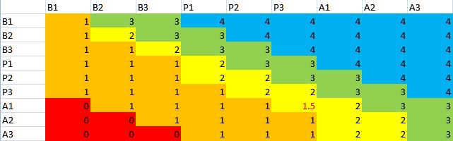
Maryland Tiered Achievement Index:
Considered Version for Go-Live Year
Expands the premium “blue area” by one diagonal.
Expands the diagonal, protecting cells A3A1, P3P2, P2P1, and mitigating A1P3.
Reflects the actual state distribution and is informed by the MSA underlying technical structure

Slide 18
MSDE had to model…
Teacher Instrument
Principal Instrument
Instrument Appendices
Calculation Methodology
Administrator Impact
Three Year Rollout
…see exhibits on msde/tpe website

Slide 19
SIP
HSA Results
AP Results
MSAs
AP
HSAs
MSA
Results
Evaluation
Summer
Spring
Fall
Winter
Current Models

Slide 20
Pre-Conference
Data Analysis
Translate MSA to %
Set SLOs
Review Annual Data
Align SIP Goals
Write SIP
SIP
HSA Results
AP Results
MSAs
AP
HSAs
MSA
Results
Evaluation
Score SLOs
Score Professional
Practice
Carry forward MSA %
Complete Rating
Affirm Attribution
Set new Professional
Practice Goals
Professional Practice
Conduct Observations
Mid-Interval SLO Check
New evaluation paradigm

Slide 21
TPE Action Team
Structure
TPE Action Team
Dave Volrath
Linda Burgee
Ilene Swirnow
Ben Feldman
Laura Motel
Psychometrician
Communication Team
Laura Motel
Field Test Team
Ben Feldman
SLO Team
Linda Burgee
Professional
Development Team
(non SLO)
Ilene Swirnow

Slide 22
Communications

Slide 23
Project Status: April 22, 2013
Completed Field Testing in all LEAs
Gathered Qualitative Data
Established Fidelity Assurance…….

Slide 24
1. What Characteristics were associated with higher degrees of implementations readiness
TPE Committee: Stakeholders & regular meetings
Built on existing Systems: Scaffold participants into new elements
Training on components of new TPE: Field test & non-field test participants
Focus on the opportunities the TPE process offers to improve instructional practice and student learning
Clear communication plans: Emphasis on common and consistent messages
Data systems: Central office, School, and Classroom… Collection, Analysis, Retrieval, and Retrieval
Collaboration with other LEAs

Slide 25
2. What variables impacted an LEA’s readiness to implement TPE
LEA size, access to funding, and central office capacity
Degree to which the LEA is developing and/or implementing a new TPE system…alignment with previous versions
Role played by local bargaining units
Existence of local common assessments
LEA preparation during 2011-2012
Central office and school administrator turnover

Slide 26
3. What issues continue to impact an LEA’s readiness to implement TPE
Timing of student assessment results with the calendar
  20% application of MSA to tested areas
Systems require significantly more time
SLOs: need to see additional models and exemplars from
different grade and content levels
Conflict between the Common Core curriculum and existing
student measures.
Benefit of more no fault time to prepare

Slide 27
…continued
Determining Quantitative Data
Defining Field Test and Project Analysis with
WestEd
Preparing for Implementation
Resource Realignment

Slide 28
TPE Action Team
Dave Volrath
Communication Team
Laura Motel
Field Test Team
Ben Feldman
SLO Team
Linda Burgee
Leadership
Development Team
Ilene Swirnow
Strategic
Delivery of
Professional
Development
Readiness

Slide 29
Next Steps…
Field Test Lessons Learned
Rating Standard Setting
PD for Principals, Executive Officers, & Evaluators
System Readiness
Teacher Readiness & Preparation
  Student Learning Objectives
  MSA/PARCC
  Common Core Standards
  Teacher Evaluation
  Professional Growth

Slide 30
Contact
Dave Volrath
dvolrath@msde.state.md.us
410 767 0504
or
MarylandPublicSchools.org/MSDE/programs/TPE

